Slide 1


Modern Operating Systems
Fifth Edition
Chapter 6
Deadlocks
Copyright © 2023, 2014, 2008 Pearson Education, Inc. All Rights Reserved
Notes:
If this PowerPoint presentation contains mathematical equations, you may need to check that your computer has the following installed:
1) Math Type Plugin
2) Math Player (free versions available)
3) NVDA Reader (free versions available)

Slide 2
Overview
Deadlock definition and modeling
Deadlock detection
Deadlock avoidance
Deadlock prevention
Deadlock handling in practice

Slide 3
System Model
System consists of resources
Resource types R₁, R₂, . . ., R_{m}
CPU cycles, memory space, I/O devices
Each resource type R_{i} has W_{i} instances.
Each process utilizes a resource as follows:
request
use
release

Slide 4
Deadlock Characterization
Deadlock can arise if four conditions hold simultaneously.
Mutual exclusion: only one process at a time can use a resource
Hold and wait: a process holding at least one resource is waiting to acquire additional resources held by other processes
No preemption: a resource can be released only voluntarily by the process holding it, after that process has completed its task
Circular wait: there exists a set {P₀, P₁, …, P_{n}} of waiting processes such that P₀ is waiting for a resource that is held by P₁, P₁ is waiting for a resource that is held by P₂, …, P_{n–1} is waiting for a resource that is held by P_{n}, and P_{n} is waiting for a resource that is held by P₀.

Slide 5
Resource-Allocation Graph
A set of vertices V and a set of edges E.
V is partitioned into two types:
P = {P₁, P₂, …, P_{n}}, the set consisting of all the processes in the system
R = {R₁, R₂, …, R_{m}}, the set consisting of all resource types in the system
request edge – directed edge P_{i} → R_{j}
assignment edge – directed edge R_{j} → P_{i}

Slide 6
Resource-Allocation Graph (Cont.)
Process
Resource Type with 4 instances
P_{i} requests instance of R_{j}
P_{i} is holding an instance of R_{j}
P_{i}
R_{j}
P_{i}
R_{j}

Slide 7
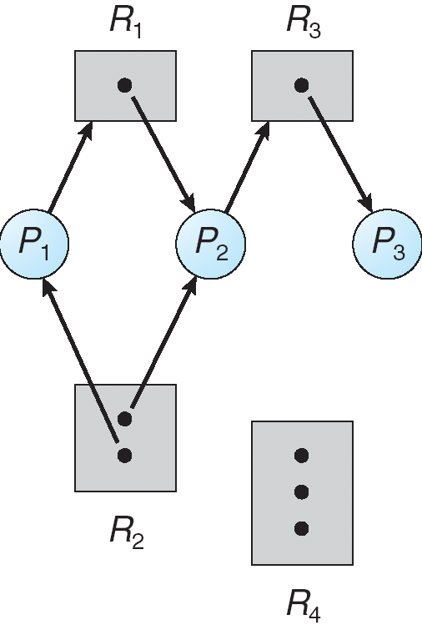
Example of a Resource Allocation Graph

Slide 8
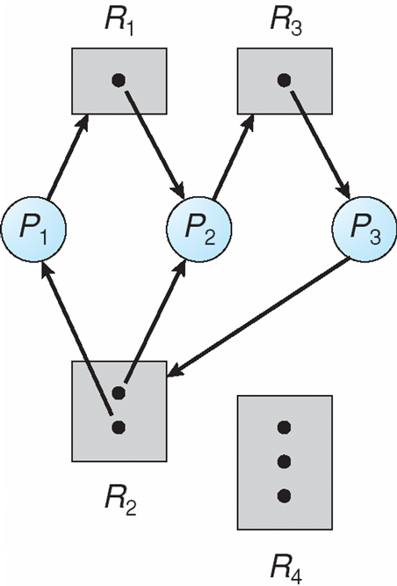
Resource Allocation Graph With A Deadlock

Slide 9
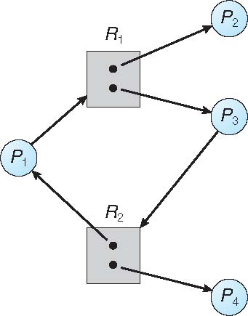
Graph With A Cycle But No Deadlock

Slide 10
Basic Facts
If graph contains no cycles ⇒ no deadlock
If graph contains a cycle ⇒
if only one instance per resource type, then deadlock
if several instances per resource type, possibility of deadlock

Slide 11
Methods for Handling Deadlocks
Ensure that the system will never enter a deadlock state:
Deadlock prevention
Deadlock avoidence
Allow the system to enter a deadlock state and then recover
Ignore the problem and pretend that deadlocks never occur in the system; used by most operating systems, including UNIX

Slide 12
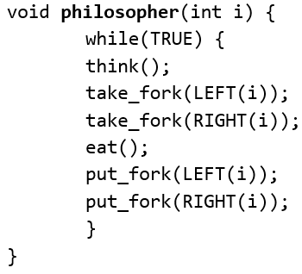
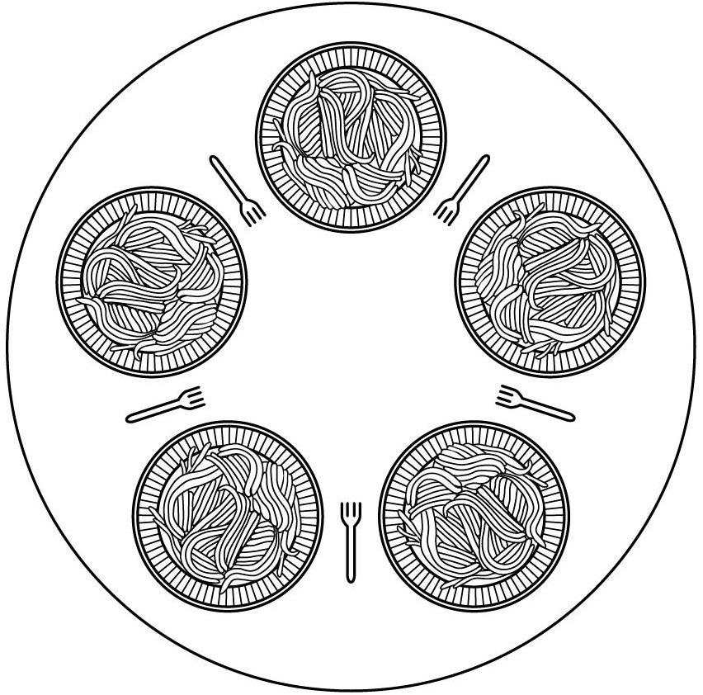
The Dining Philosophers Problem (1)
There are 5 philosophers, each seated at a round table in front of a plate of spaghetti. A philosopher needs 2 forks to eat the spaghetti, located on his left and his right.
Obvious (non)solution:
Notes:
Long Description:
The code from top to bottom reads as follows. Void philosopher left parenthesis int i right parenthesis left brace; while left parenthesis true right parenthesis left brace; think left parenthesis right parenthesis; take underscore fork left parenthesis left left parenthesis i right parenthesis right parenthesis semicolon; take underscore fork left parenthesis right left parenthesis i right parenthesis right parenthesis semicolon; eat left parenthesis right parenthesis semicolon; put underscore fork left parenthesis left left parenthesis i right parenthesis right parenthesis semicolon; put underscore fork left parenthesis right left parenthesis i right parenthesis right parenthesis semicolon; right brace; right brace.

Slide 13
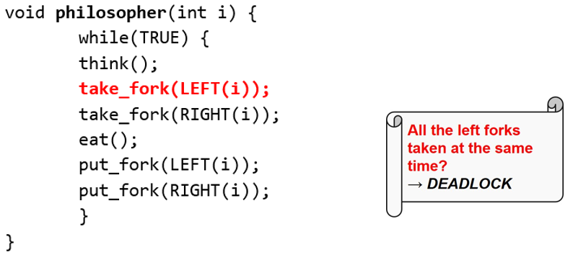
The Dining Philosophers Problem (2)
There are 5 philosophers, each seated at a round table in front of a plate of spaghetti. A philosopher needs 2 forks to eat the spaghetti, located on his left and his right.
Obvious (non)solution:
Notes:
Long Description:
The code from top to bottom reads as follows. Void philosopher left parenthesis int i right parenthesis left brace; while left parenthesis true right parenthesis left brace; think left parenthesis right parenthesis; take underscore fork left parenthesis left left parenthesis i right parenthesis right parenthesis semicolon; take underscore fork left parenthesis right left parenthesis i right parenthesis right parenthesis semicolon; eat left parenthesis right parenthesis semicolon; put underscore fork left parenthesis left left parenthesis i right parenthesis right parenthesis semicolon; put underscore fork left parenthesis right left parenthesis i right parenthesis right parenthesis semicolon; right brace; right brace. On the left, an illustration of a scroll with the text that reads as follows. All the left forks taken at the same time question right arrow deadlock.

Slide 14
Resource Deadlocks: Examples
Dining Philosophers: Everybody starts by taking the left fork
Four cars arrive simultaneously at a junction and each yields to the car on the right
Process A opens file #1 and tries to open file #2. File #2 is currently opened by Process B and Process B waits for file #1

Slide 15
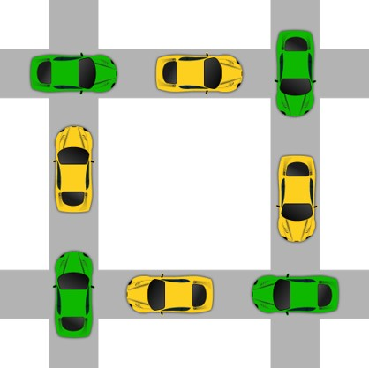
Deadlock
Nothing flows, everything hangs

Slide 16
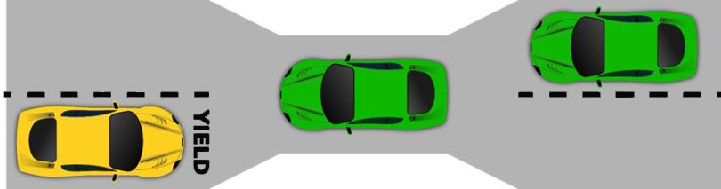
Starvation
Resource: The narrow bridge
Access: Traffic from the right (the yellow car) has right of way
Deadlock resolution: Cars back up (preemption & rollback)
Starvation is possible

Slide 17
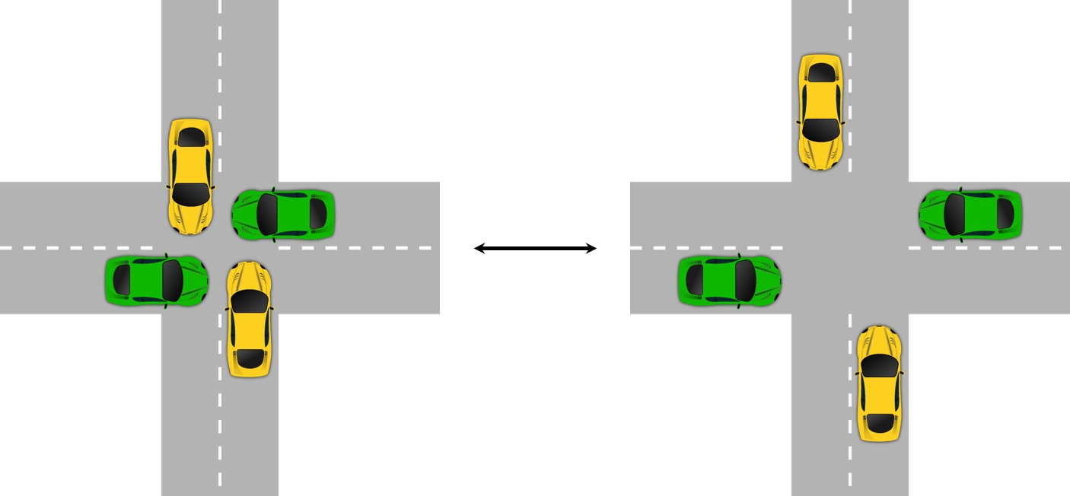
Livelock (1 of 2)
Many operations executed, but no progress

Slide 18
Deadlock Handling
Strategies are used for dealing with deadlocks:
Ignore the problem
No action taken
Deadlock detection
Detect deadlock and perform recovery actions
Deadlock avoidance
Carefully allocate resources to avoid deadlocks
Deadlock prevention
Structurally prevent any of the deadlock conditions

Slide 19
Ignore the Problem
Also known as the ostrich algorithm
Cost-effective solution to deadlocks
Assumes deadlocks are rare
Assumes cost of handling deadlocks is high
Assumes effects of deadlocks are tolerable
Simplest solution to manage system resources, i.e., process table, inode table, swap space, etc.

Slide 20
Overview (3 of 6)
Deadlock definition and modeling
Deadlock detection
Deadlock avoidance
Deadlock prevention
Deadlock handling in practice

Slide 21
Deadlock Detection
Allow system to enter deadlock state
Detection algorithm
Recovery scheme

Slide 22
Single Instance of Each Resource Type
Maintain wait-for graph
Nodes are processes
P_{i} → P_{j} if P_{i} is waiting for P_{j}
Periodically invoke an algorithm that searches for a cycle in the graph. If there is a cycle, there exists a deadlock
An algorithm to detect a cycle in a graph requires an order of n² operations, where n is the number of vertices in the graph

Slide 23
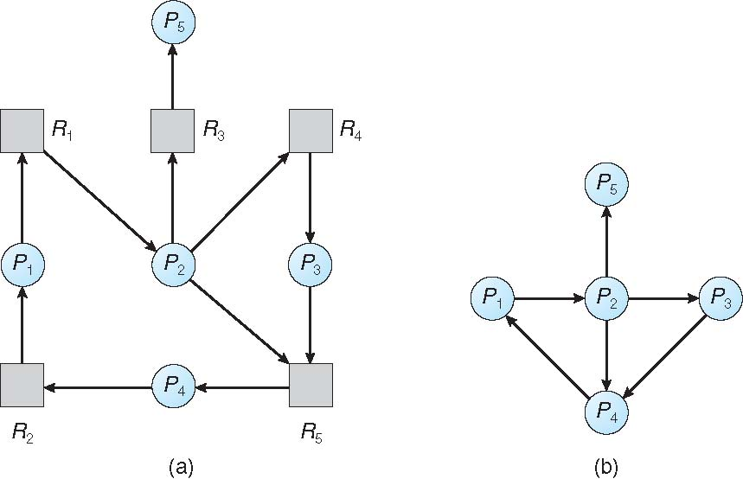
Resource-Allocation Graph and Wait-for Graph
Resource-Allocation Graph
Corresponding wait-for graph

Slide 24
Several Instances of a Resource Type
Available: A vector of length m indicates the number of available resources of each type
Allocation: An n x m matrix defines the number of resources of each type currently allocated to each process
Request: An n x m matrix indicates the current request of each process. If Request [i][j] = k, then process P_{i} is requesting k more instances of resource type R_{j}.

Slide 25
Detection Algorithm
1. Let Work and Finish be vectors of length m and n, respectively Initialize:
(a) Work = Available
(b) For i = 1,2, …, n, if Allocation_{i} ≠ 0, then Finish[i] = false; otherwise, Finish[i] = true
2. Find an index i such that both:
(a) Finish[i] == false
(b) Request_{i} ≤ Work
If no such i exists, go to step 4

Slide 26
Detection Algorithm (Cont.)
3. Work = Work + Allocation_{i} Finish[i] = true go to step 2
4. If Finish[i] == false, for some i, 1 ≤ i ≤ n, then the system is in deadlock state. Moreover, if Finish[i] == false, then P_{i} is deadlocked
Algorithm requires an order of O(m x n²) operations to detect whether the system is in deadlocked state

Slide 27
Example of Detection Algorithm
Five processes P₀ through P₄; three resource types A (7 instances), B (2 instances), and C (6 instances)
Snapshot at time T₀:
Allocation Request Available
A B C A B C A B C
P₀ 0 1 0 0 0 0 0 0 0
P₁ 2 0 0 2 0 2
P₂ 3 0 3 0 0 0
P₃ 2 1 1 1 0 0
P₄ 0 0 2 0 0 2
Sequence <P₀, P₂, P₃, P₁, P₄> will result in Finish[i] = true for all i

Slide 28
Example (Cont.)
P₂ requests an additional instance of type C
Request
A B C
P₀ 0 0 0
P₁ 2 0 2
P₂ 0 0 1
P₃ 1 0 0
P₄ 0 0 2
State of system?
Can reclaim resources held by process P₀, but insufficient resources to fulfill other processes; requests
Deadlock exists, consisting of processes P₁, P₂, P₃, and P₄

Slide 29
Detection-Algorithm Usage
When, and how often, to invoke depends on:
How often a deadlock is likely to occur?
How many processes will need to be rolled back?
one for each disjoint cycle
If detection algorithm is invoked arbitrarily, there may be many cycles in the resource graph and so we would not be able to tell which of the many deadlocked processes “caused” the deadlock.

Slide 30
Recovery from Deadlock: Process Termination
Abort all deadlocked processes
Abort one process at a time until the deadlock cycle is eliminated
In which order should we choose to abort?
Priority of the process
How long process has computed, and how much longer to completion
Resources the process has used
Resources process needs to complete
How many processes will need to be terminated
Is process interactive or batch?

Slide 31
Recovery from Deadlock: Resource Preemption
Selecting a victim – minimize cost
Rollback – return to some safe state, restart process for that state
Starvation – same process may always be picked as victim, include number of rollback in cost factor

Slide 32
Deadlock Prevention
Restrain the ways request can be made
Mutual Exclusion – not required for sharable resources (e.g., read-only files); must hold for non-sharable resources
Hold and Wait – must guarantee that whenever a process requests a resource, it does not hold any other resources
Require process to request and be allocated all its resources before it begins execution, or allow process to request resources only when the process has none allocated to it.
Low resource utilization; starvation possible

Slide 33
Deadlock Prevention (Cont.)
No Preemption –
If a process that is holding some resources requests another resource that cannot be immediately allocated to it, then all resources currently being held are released
Preempted resources are added to the list of resources for which the process is waiting
Process will be restarted only when it can regain its old resources, as well as the new ones that it is requesting
Circular Wait – impose a total ordering of all resource types, and require that each process requests resources in an increasing order of enumeration

Slide 34
Deadlock Example
/* thread one runs in this function */
void *do_work_one(void *param) {
pthread_mutex_lock(&first_mutex);
pthread_mutex_lock(&second_mutex);
/** * Do some work */ pthread_mutex_unlock(&second_mutex);
pthread_mutex_unlock(&first_mutex);
pthread_exit(0);
}
/* thread two runs in this function */
void *do_work_two(void *param) {
pthread_mutex_lock(&second_mutex);
pthread_mutex_lock(&first_mutex);
/** * Do some work */ pthread_mutex_unlock(&first_mutex);
pthread_mutex_unlock(&second_mutex);
pthread_exit(0);
}

Slide 35
Deadlock Example with Lock Ordering
void transaction(Account from, Account to, double amount)
{
mutex lock1, lock2;
lock1 = get_lock(from);
lock2 = get_lock(to);
acquire(lock1);
acquire(lock2);
withdraw(from, amount);
deposit(to, amount);
release(lock2);
release(lock1);
}
Transactions 1 and 2 execute concurrently. Transaction 1 transfers $25 from account A to account B, and Transaction 2 transfers $50 from account B to account A

Slide 36
Deadlock Avoidance
Requires that the system has some additional a priori information available
Simplest and most useful model requires that each process declare the maximum number of resources of each type that it may need
The deadlock-avoidance algorithm dynamically examines the resource-allocation state to ensure that there can never be a circular-wait condition
Resource-allocation state is defined by the number of available and allocated resources, and the maximum demands of the processes

Slide 37
Safe State
When a process requests an available resource, system must decide if immediate allocation leaves the system in a safe state
System is in safe state if there exists a sequence <P₁, P₂, …, P_{n}> of ALL the processes in the systems such that for each P_{i}, the resources that P_{i} can still request can be satisfied by currently available resources + resources held by all the P_{j}, with j < I
That is:
If P_{i} resource needs are not immediately available, then P_{i} can wait until all P_{j} have finished
When P_{j} is finished, P_{i} can obtain needed resources, execute, return allocated resources, and terminate
When P_{i} terminates, P_{i +1} can obtain its needed resources, and so on

Slide 38
Basic Facts
If a system is in safe state ⇒ no deadlocks
If a system is in unsafe state ⇒ possibility of deadlock
Avoidance ⇒ ensure that a system will never enter an unsafe state.

Slide 39
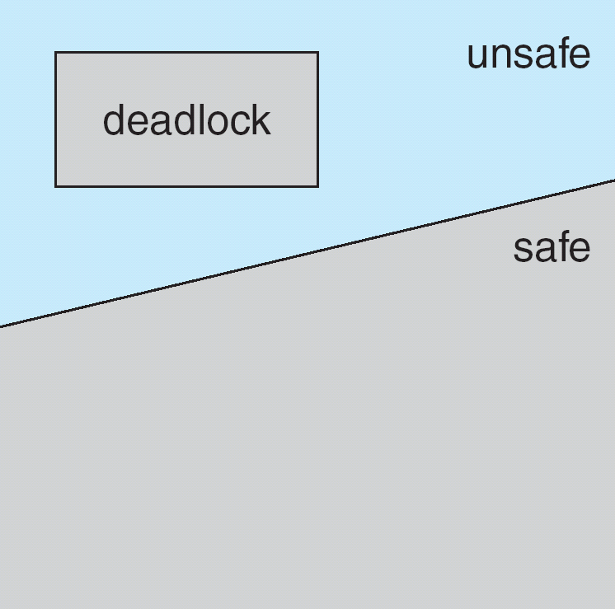
Safe, Unsafe, Deadlock State

Slide 40
Avoidance Algorithms
Single instance of a resource type
Use a resource-allocation graph
Multiple instances of a resource type
Use the banker’s algorithm

Slide 41
Resource-Allocation Graph Scheme
Claim edge P_{i} → R_{j} indicated that process P_{j} may request resource R_{j}; represented by a dashed line
Claim edge converts to request edge when a process requests a resource
Request edge converted to an assignment edge when the resource is allocated to the process
When a resource is released by a process, assignment edge reconverts to a claim edge
Resources must be claimed a priori in the system

Slide 42
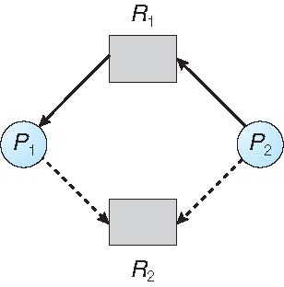
Resource-Allocation Graph

Slide 43
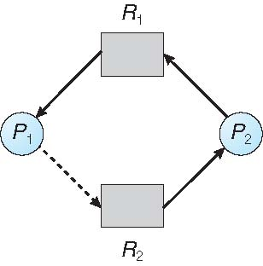
Unsafe State In Resource-Allocation Graph

Slide 44
Resource-Allocation Graph Algorithm
Suppose that process P_{i} requests a resource R_{j}
The request can be granted only if converting the request edge to an assignment edge does not result in the formation of a cycle in the resource allocation graph

Slide 45
Banker’s Algorithm
Multiple instances
Each process must a priori claim maximum use
When a process requests a resource it may have to wait
When a process gets all its resources it must return them in a finite amount of time

Slide 46
Data Structures for the Banker’s Algorithm
Let n = number of processes, and m = number of resources types.
Available: Vector of length m. If available [j] = k, there are k instances of resource type R_{j} available
Max: n x m matrix. If Max [i,j] = k, then process P_{i} may request at most k instances of resource type R_{j}
Allocation: n x m matrix. If Allocation[i,j] = k then P_{i} is currently allocated k instances of R_{j}
Need: n x m matrix. If Need[i,j] = k, then P_{i} may need k more instances of R_{j} to complete its task
Need [i,j] = Max[i,j] – Allocation [i,j]

Slide 47
Safety Algorithm
1. Let Work and Finish be vectors of length m and n, respectively. Initialize:
Work = Available
Finish [i] = false for i = 0, 1, …, n- 1
2. Find an i such that both:
(a) Finish [i] = false
(b) Need_{i} ≤ Work
If no such i exists, go to step 4
3. Work = Work + Allocation_{i} Finish[i] = true go to step 2
4. If Finish [i] == true for all i, then the system is in a safe state

Slide 48
Resource-Request Algorithm for Process P_{i}
Request_{i} = request vector for process P_{i}. If Request_{i} [j] = k then process P_{i} wants k instances of resource type R_{j}
1. If Request_{i} ≤ Need_{i} go to step 2. Otherwise, raise error condition, since process has exceeded its maximum claim
2. If Request_{i} ≤ Available, go to step 3. Otherwise P_{i} must wait, since resources are not available
3. Pretend to allocate requested resources to P_{i} by modifying the state as follows:
Available = Available – Request_{i};
Allocation_{i} = Allocation_{i} + Request_{i};
Need_{i} = Need_{i} – Request_{i};
If safe ⇒ the resources are allocated to P_{i}
If unsafe ⇒ P_{i} must wait, and the old resource-allocation state is restored

Slide 49
Example of Banker’s Algorithm
5 processes P₀ through P₄;
3 resource types:
A (10 instances), B (5instances), and C (7 instances)
Snapshot at time T₀:
Allocation Max Available
A B C A B C A B C
P₀ 0 1 0 7 5 3 3 3 2
P₁ 2 0 0 3 2 2
P₂ 3 0 2 9 0 2
P₃ 2 1 1 2 2 2
P₄ 0 0 2 4 3 3

Slide 50
Example (Cont.)
The content of the matrix Need is defined to be Max – Allocation
Need
A B C
P₀ 7 4 3
P₁ 1 2 2
P₂ 6 0 0
P₃ 0 1 1
P₄ 4 3 1
The system is in a safe state since the sequence < P₁, P₃, P₄, P₂, P₀> satisfies safety criteria

Slide 51
Modern Operating Systems
Fifth Edition
Chapter 6 - End
Deadlocks
Copyright © 2023, 2014, 2008 Pearson Education, Inc. All Rights Reserved
Notes:
If this PowerPoint presentation contains mathematical equations, you may need to check that your computer has the following installed:
1) Math Type Plugin
2) Math Player (free versions available)
3) NVDA Reader (free versions available)

